Slide 1
















Group project: Spotify’s buzz analysis
Start Presentation
Big Data Based Marketing Analytics

Slide 2







About us
Spotify
Spotify is a digital music, podcast, and video service that gives you access to millions of songs and other content from creators all over the world.
Basic functions such as playing music are totally free, but you can also choose to upgrade to Spotify Premium.
Whether customers have Premium or not, they can:
Get recommendations based on their taste
Build collections of music and podcasts And more!
Group Project
About Spotify
Group Members
Overview Topics
Competitors Analysis
Reviews Data & Semantic Analysis
Topic Modeling
Conclusions

Slide 3



Group Project
Group Members
About us
Group Members
Overview Topics
Competitors Analysis
Reviews Data & Semantic Analysis
Topic Modeling
Seif Yacoub
Tarek Mestrah
Amal Yakubov
Conclusions

Slide 4




Group Project
Overview Topics
About us
Group Members
Overview Topics
Competitors Analysis
Reviews Data Parsing
Data Preprocessing
Competitors Analysis
Reviews Data & Semantic Analysis
Topic Modeling
Conclusions
Semantic Analysis
Topic Modeling
The Conclusions

Slide 5



Competitors Analysis
Group Project
About us
Group Members
Overview Topics
Competitors Analysis
Spotify Competitors in Russia
Reviews Data & Semantic Analysis
Yandex Music
Apple Music
VK Music
Zvuk Music
Platform | Service Name | Price/Month
Spotify | Spotify Premium | 169 RUB
VK Music | VK Combo | 159 RUB
Yandex Music |  | 299 RUB
Apple Music | Individual | 169 RUB
Zvuk |  | 169 RUB
Topic Modeling
Conclusions

Slide 6
Spotify Competitive Advantages
Group Project
About us
A. Spotify has a larger library of music tracks than its direct competitors.
B. All services do an excellent job of music recommendations and user preferences, but Spotify is somewhat better because it also has a larger library.
C. The search for foreign music is much faster and clearer in Spotify, but the Russian-speaking segment of the music world is better and easier to search in Yandex Music and other Russian platforms.
D. High quality and user-friendly interface.
E. Spotify can gather more user’s data, so the user data at Spotify is a valuable resource that allows Spotify to use machine learning and artificial intelligence to give users a personalized listening experience
Group Members
Overview Topics
Competitors Analysis
Reviews Data & Semantic Analysis
Topic Modeling
Conclusions

Slide 7

Data: scraping and preprocessing
Group Project
About us
1. Data retrieved from google play store (link)
2. Data was retrieved with a Python library google-play-scraper
3. Data was splitted into 5 columns: time_submitted, review, rating, author_account_name, reply (link)
4. We set the review filter to English for a clearer analysis
Group Members
Overview Topics
Competitors Analysis
Review Data & Semantic Analysis
Topic Modeling
Conclusions

Slide 8
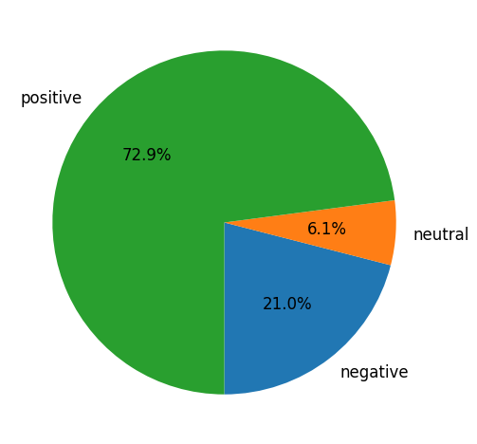
Semantic Analysis & NPS
Group Project
Semantic analysis helps us study and analyse the impact and influence of the services we provide.
About us
Group Members
We used the dataset with thousands of reviews to analyze the user’s ratings.
Overview Topics
Competitors Analysis
72.9% of the analyzed reviews are positive while 21% were negative.
Reviews Data & Semantic Analysis
Topic Modeling
Link to Colab: https://colab.research.google.com/drive/1i-mzt8p1hD7lBjeEkQ9KoSI-L3nIW-lo?usp=sharing#scrollTo=qmMRholJ9nCq
Conclusions

Slide 9
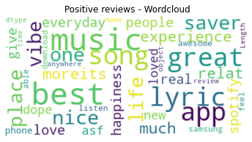
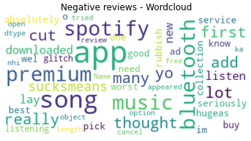
Semantic Analysis & NPS
Group Project
As seen below, the top words used in the reviews were analyzed and split into 2, the most used in positive reviews and the top used in negative reviews.
About us
Group Members
Overview Topics
Competitors Analysis
Reviews Data & Semantic Analysis
Topic Modeling
The Net Promoter Score(NPS) was calculated in the code, the result is 51.93%
Conclusions

Slide 10
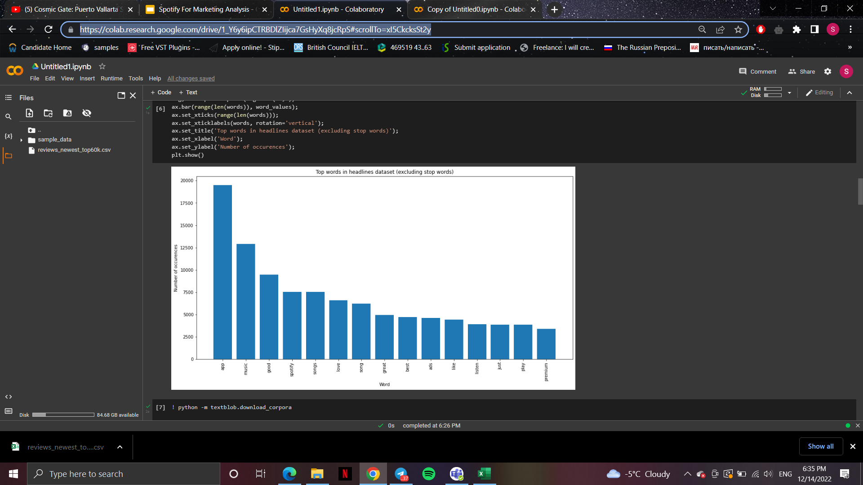

Group Project
Topic Modeling
About us
Group Members
Overview Topics
Competitors Analysis
Reviews Data & Semantic Analysis
Topic Modeling
In the topic modeling (link) we can see the top words
Conclusions

Slide 11
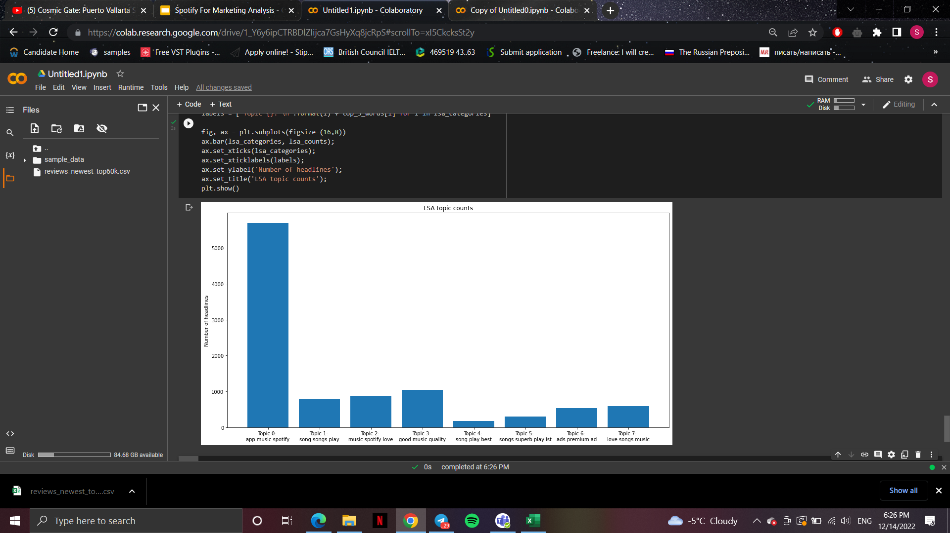
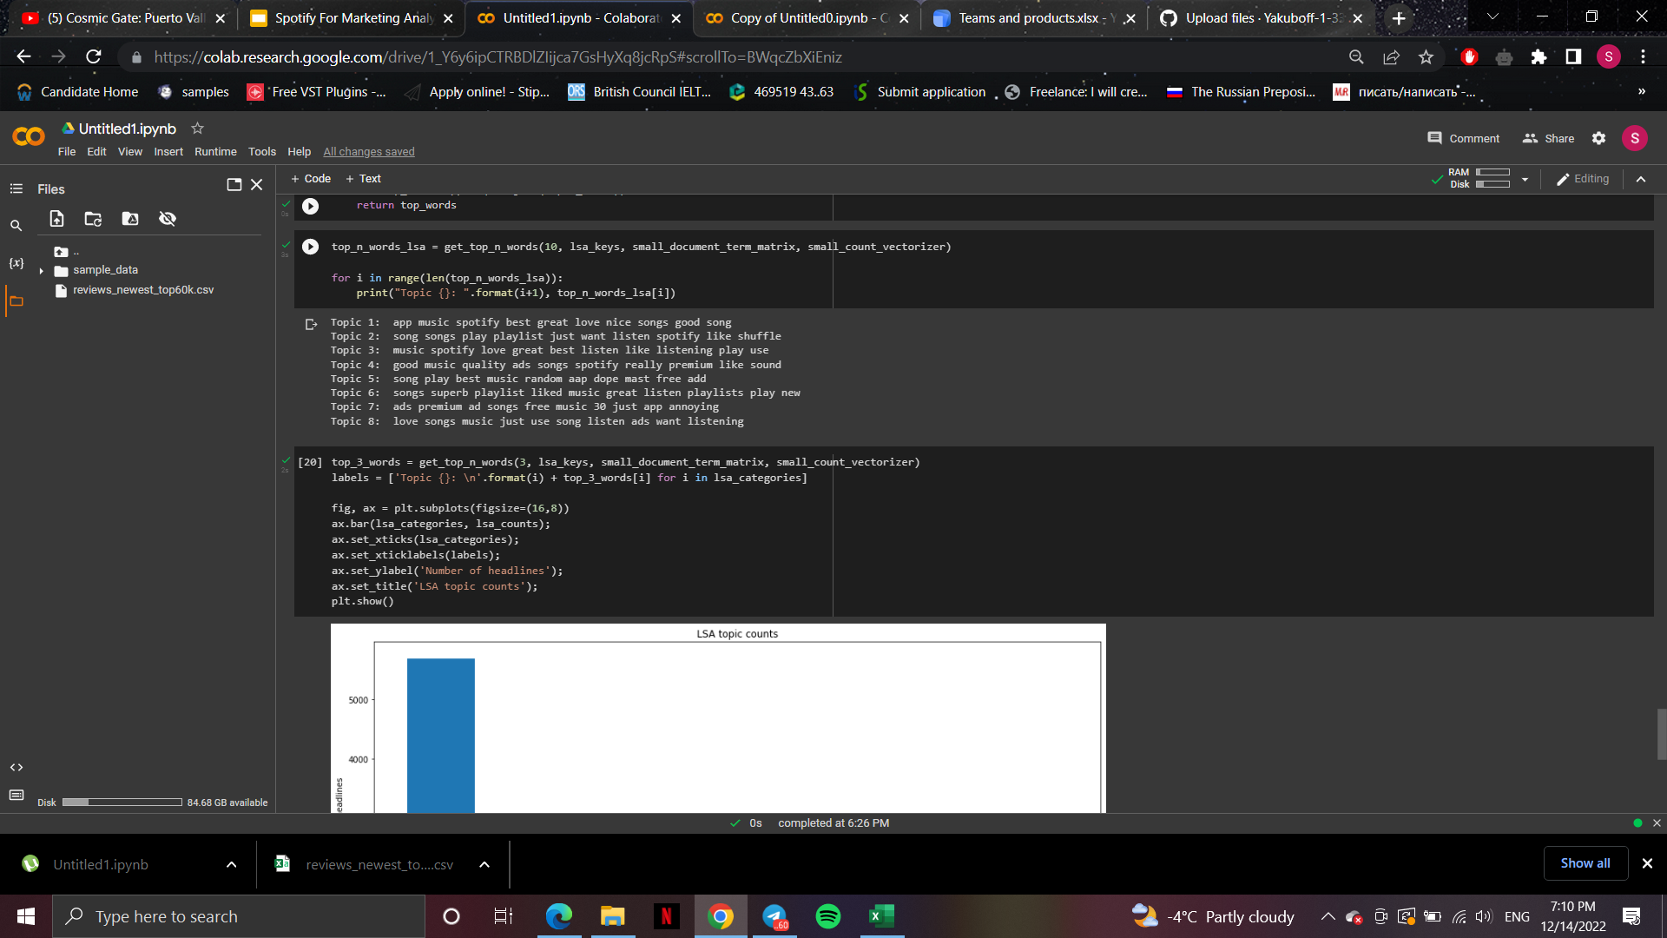
Group Project
Topic Modeling
About us
Group Members
Overview Topics
Competitors Analysis
Reviews Data & Semantic Analysis
Topic Modeling
Conclusions

Slide 12


Conclusions
Group Project
About us
Group Members
In conclusion from the sentiment analysis we see most of the reviews are positive, that’s why Spotify is growing fast. Also, Spotify has more competitive advantages than its competitors for various reasons. One of them is the number of users and the number of libraries which makes it better in processing the data and creating recommendation systems better than the competitors. On the other hand, this study shows that Spotify for Russian music listeners and navigators might not be as effective as for the other foreign languages. Therefore, Yandex music takes a huge partition of the Russian market and now after the sanctions almost all Russians are not able to use Spotify .
Overview Topics
Competitors Analysis
Reviews Data & Semantic Analysis
Topic Modeling
Conclusions

Slide 13
Group Project
Thanks

